Slide 1

ARTIFICIAL INTELLIGENCE FINAL PROJECT
BY
YASASWINI SURYADEVARA

Slide 2
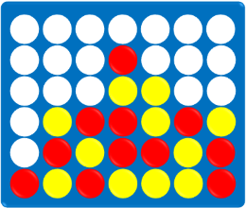
CONNECT4

Slide 3
WHAT IS THE GAME?
Connect4 is a two-player connection board game.
In this the players choose a color and then take turns dropping colored discs into a seven-column, six-row vertically suspended grid.
The pieces fall straight down, occupying the lowest available space within the column.

Slide 4
HOW TO WIN?
In order to win, a player must get four checkers in their color in a row. Whoever does it first is the winner. There are three ways to get four checkers in a row in Connect4: horizontally, vertically, and diagonally.

Slide 5

LET'S PLAY CONNECT4

Slide 6
APPROACH
We have a scoring mechanism. We will be assigning scores and punishment depending on the moves players make.
The search algorithms that will be used are
1.Minmax Search Algorithm
2.Alpha beta pruning
Minmax Search Algorithm
The goal state is either of the players winning or all the discs in the game should be used, we will be returning the heuristic value of board or recursively check for best score depending on scores we have allotted.
Alpha Beta Pruning
We will be using alpha beta pruning to minimize the search space. We construct a game tree where each node represents a possible game state. The internals nodes at even depth would represent either initial game state or game state obtained by moves made by opponent. The internal nodes at odd depth represent game states obtained from moves made by us. If state is game end it is a leaf node. Each leaf node will be allotted certain score and it will not be further expanded.

Slide 7

THANK YOU

